Slide 1
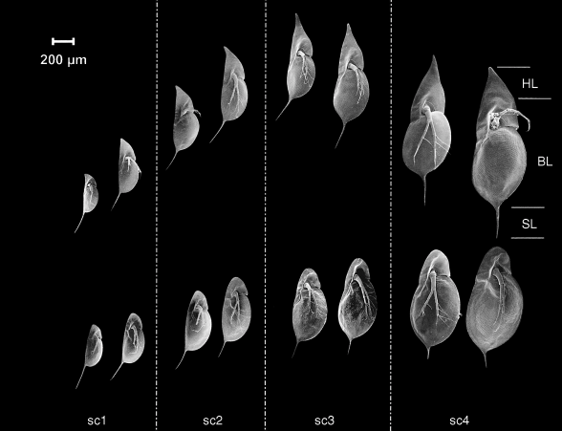
Adaptive Phenotypic Plasticity and Epigenetics
Kevin Wong
BIO 594 | Feb. 28 2019

Slide 2
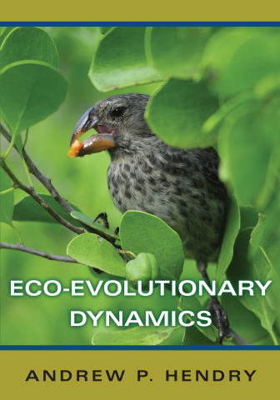
Outline Phenotypic Plasticity
Q1: What is phenotypic plasticity?
Q2: Is plasticity adaptive?
Q3: What are the cost- benefits of plasticity?
Q4: Does plasticity promote or constrain genetic evolution?
Q5: How can we quantify phenotypic plasticity?

Slide 3
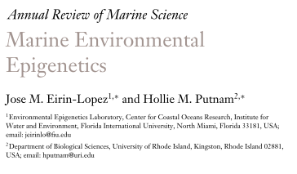
Outline Epigenetics
Q1: What is epigenetics?
Q2: Epigenetic effect vs inheritance
Q3: What are epigenetic mechanisms?
Q4: How can we quantify epigenetics?
Q5: What is the epigenetic role in environmental acclimatization?

Slide 4
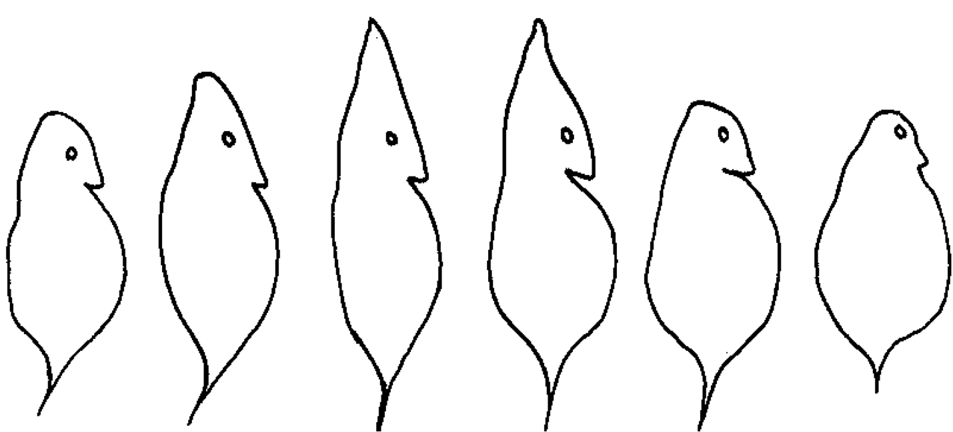
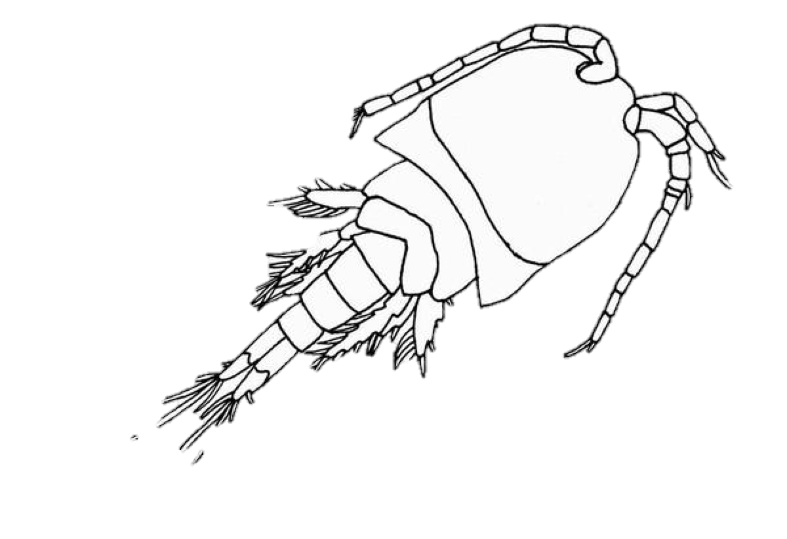
Q1: What is phenotypic plasticity?
“The ability of one genotype to express different phenotypes in different environments”
Phenotype

Slide 5
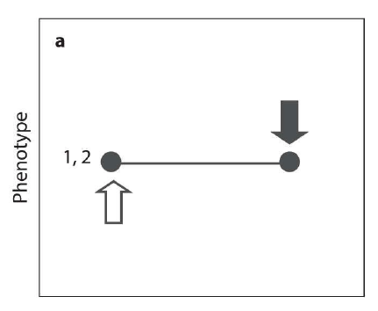
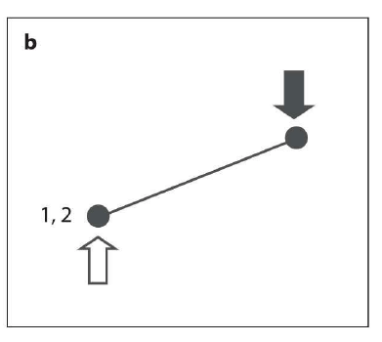
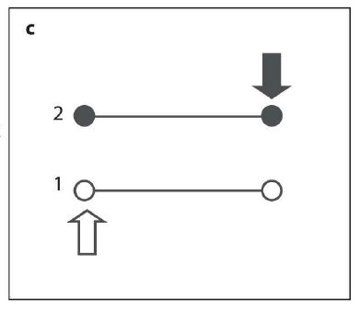
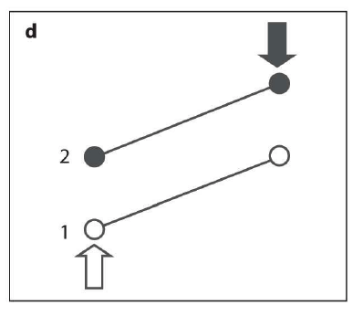
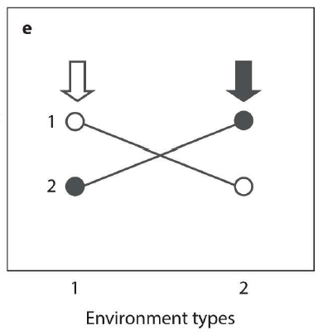
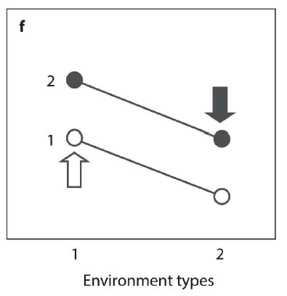
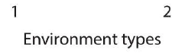
Environment (E), Genotype (G), or both (GXE)?
No E, No G
Yes E, No G
No E, Yes G
Yes E, Yes G
Yes E, Yes G, GXE
Yes E, Yes G
Notes:
Dot colors are genotypes
Arrows are genotypes “native” environment
GXE

Slide 6
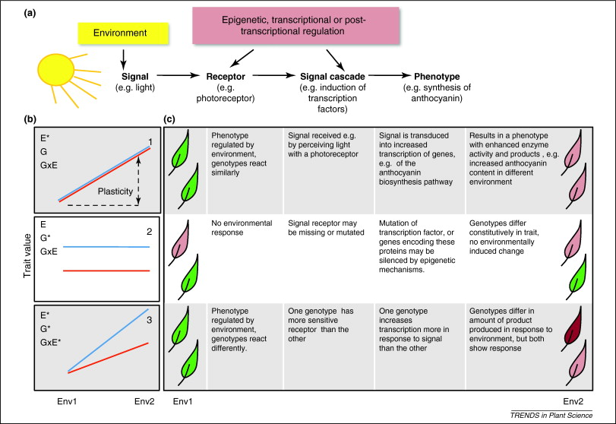
Plasticity and Reaction Norms
Nicotra et al. 2010

Slide 7
Q1: What is phenotypic plasticity?
Within-generation (WGP)
A change in phenotype within the same individual under altered environmental conditions
Trans-generational (TGP)
Differences in offspring phenotype that occur due to the interaction between the current generation and previous generation’s environmental conditions
But what defines different generations?

Slide 8
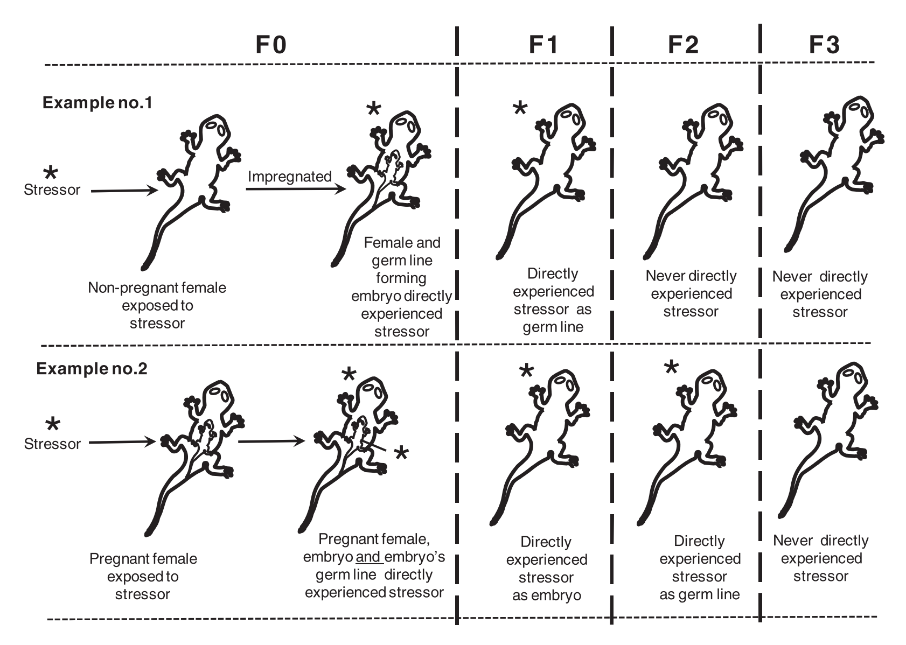
Types of plasticity: WGP and TGP
WGP (Adult)
WGP (Offspring)
TGP
WGP (Adult)
TGP
WGP (Offspring)
Ho and Burggren, 2010

Slide 9
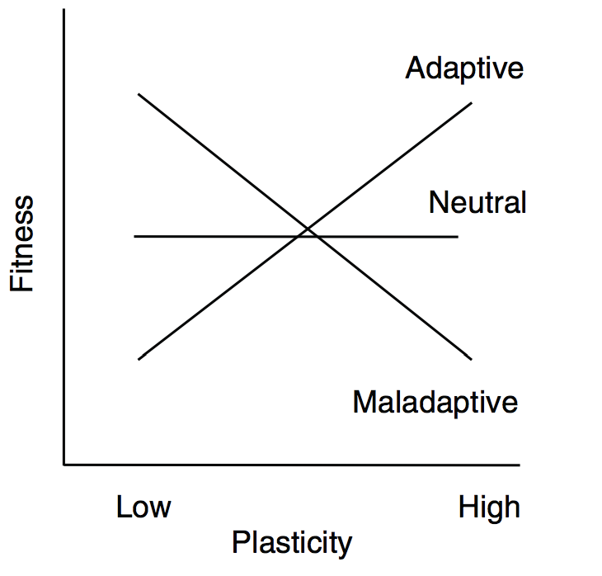
Q2: Is plasticity adaptive?
“Plasticity is sometimes adaptive, sometimes maladaptive, and sometimes neutral”
– Andrew Hendry
Nicotra et al. 2010

Slide 10
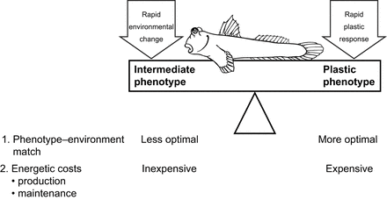
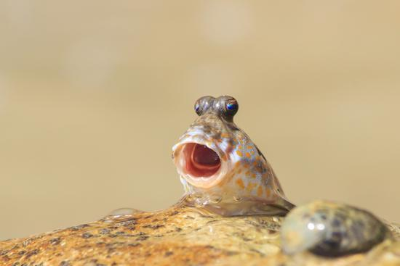
Q3: What are the cost-benefits of plasticity?
Energetic costs:
Building new structures (and reversing)
Maintenance costs for detecting environmental change
Lag time effects – when is it worth it?
Wright and Turko, 2016
Notes:
Rock skipper fish
The trade offs between expressing plastic or non-plastice intermediate traits → amphibous fish moving from aquatic to terrestrial habitats
Plastic responses provide a more optimal match to the new environment, despite the high energetic costs incurred to produce and maintain the phenotype
Alternatively intermediate phenotypes that may be less optimal in a particular environment, but do well enough across environments, will be selected for in situations where there is frequent or rapid environmental change
Plasticity is costly because it involves energetic costs associated with both (1) building new structures or molecules and including reversal costs and (2) maintenance costs for genetic, sensory, and physiological or regulatory mechanisms to detect and respond to to environmental change
Lag time limits the effectiveness of plasticity may explain by reversible gill remodelling during air exposure (which takes 2-3 weeks to express) has evolved in species such as mangrove rivulus and lungfish which remain out of water during seasonal droughts, but not mudskippers which move back and forth during the day

Slide 11
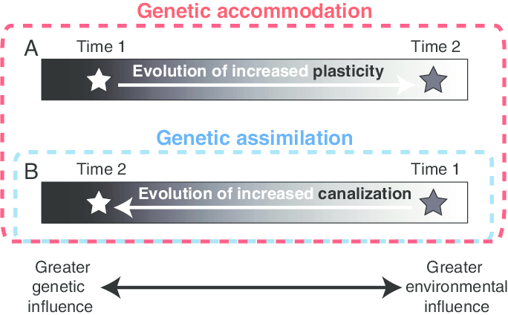
Q5: Does plasticity promote or constrain evolution?
Genetic canalization
Genetic assimilation

Slide 12
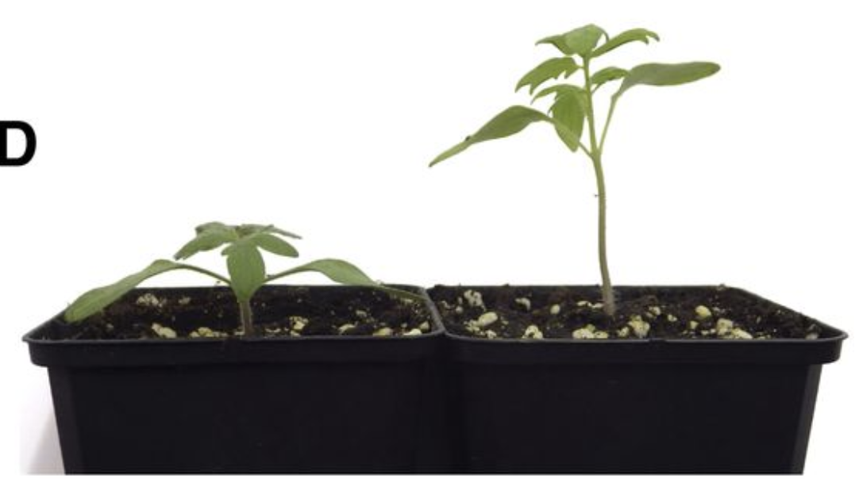
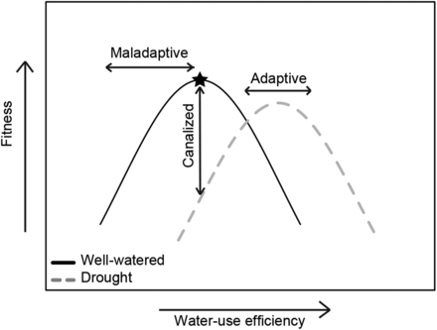
Q4: Does plasticity promote or constrain evolution?
Genetic canalization
Phenotypic robustness to environmental change
Becklin et al. 2016
Notes:
In Well watered conditions, stabilizing selection favours immediate WUE because low → dessication, and high → reduced growth
Drought stress shifts fitness function, such as optimal fitness now occurs at higher WUE
Plasticity is adaptive when the novel trait values produce similar or higher fitness than the former trait values could have achieved under drought conditions
If WUE mea does not change, the the trait is canalized and could restrict population persistence
Plasticity can also be maladaptive and reduce fitness leading to pop declines

Slide 13
Q4: Does plasticity promote or constrain evolution?
Disruptive Selection
Genetic assimilation
When a change on phenotype in response to an environmental change is selected for
Does this increase or decrease long term plasticity?
Frequency
Phenotype
Environment

Slide 14
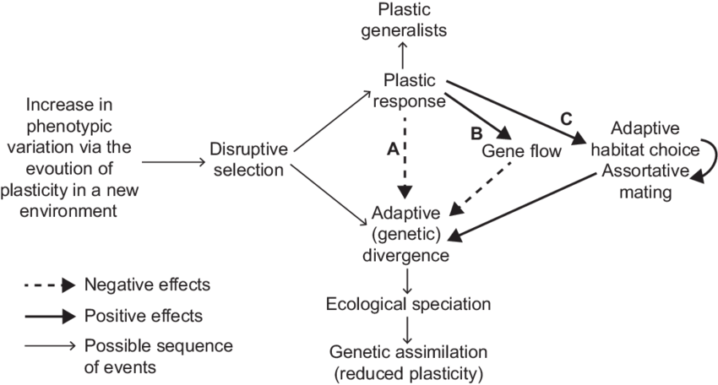
Does this increase or decrease long term plasticity?
Nonaka et al. 2015
Notes:
Plasticity can influence adaptive divergence different ways
Weakened disruptive selection
Increased gene flow
Enhanced adaptive habitat choice and assortive mating
If plastic responses weaken disruptive selection (A) or increase gene flow between diverging phenotypes (B), results in plastic generalists
If adaptive habitat choice and assortive mating are strong, plasticity promtes the formation of reproductive barrier and promoting adaptive divergence through reproductive isolation
If plasticity is costly, further adaptation may cause plasticity via genetic assimilation

Slide 15
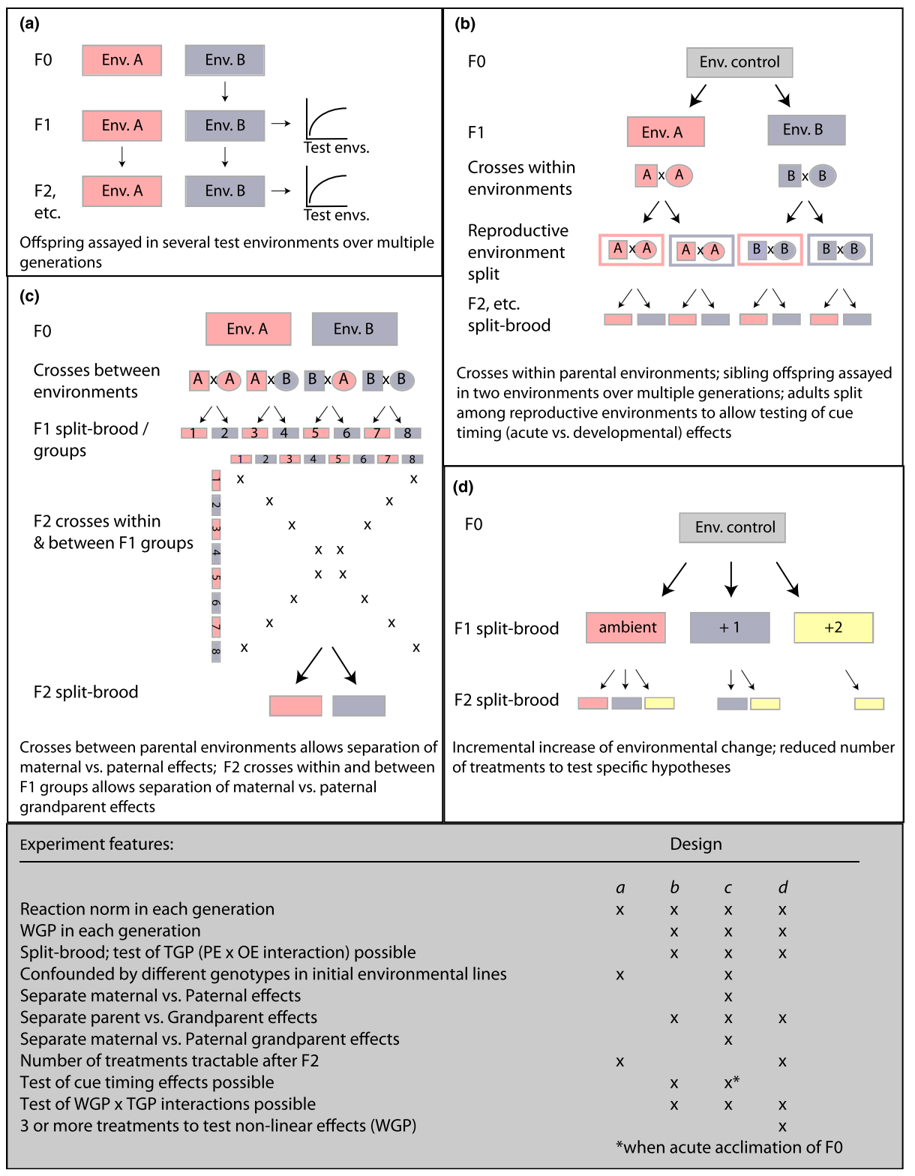
Q5: How can we quantify phenotypic plasticity?
Experimental Design matching the hypothesis
Known plastic traits and how to measure them
Are they heritable?
Donelson et al. 2017

Slide 16
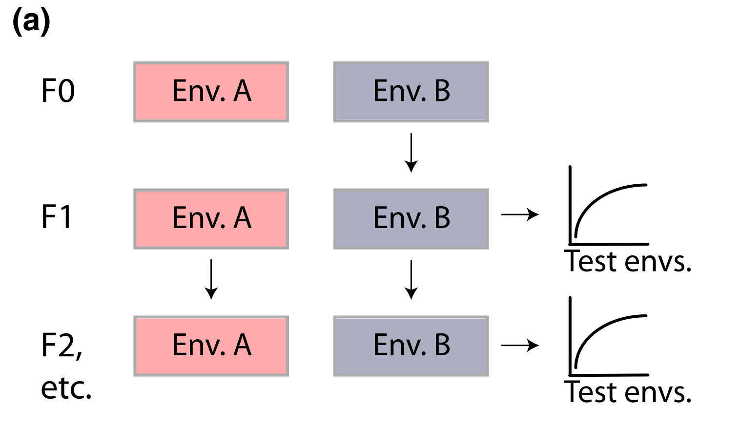
Q5: How can we quantify phenotypic plasticity?
Experimental Design (a):
Population Level
Rxn norm for each generation
Confounded by different genotypes in each environmental line
Donelson et al. 2017
Notes:
Offspring assayed in several test environments over multiple generations

Slide 17
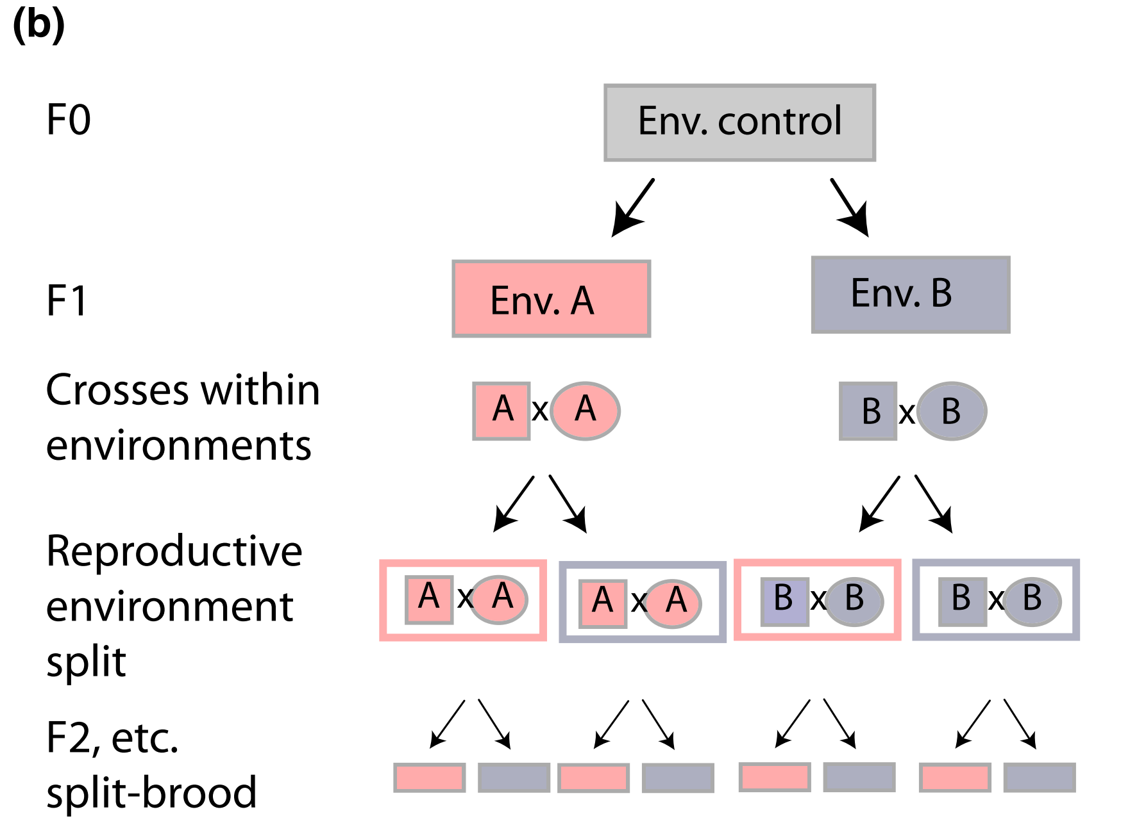
Q5: How can we quantify phenotypic plasticity?
Experimental Design (b):
Rxn norm for each generation
WGP in each generation
Split –brood, testing TGP (PE X OE)
Separate parent/grandparent effects
Can test for cue timing effects
Can test WGP X TGP interactions
Donelson et al. 2017
Notes:
Crosses within parental environments
Sibling offspring assayed in two environments over multiple generations
Adults split among reproductive environments to allow testing of cue timing (acute vs developmental) effects

Slide 18
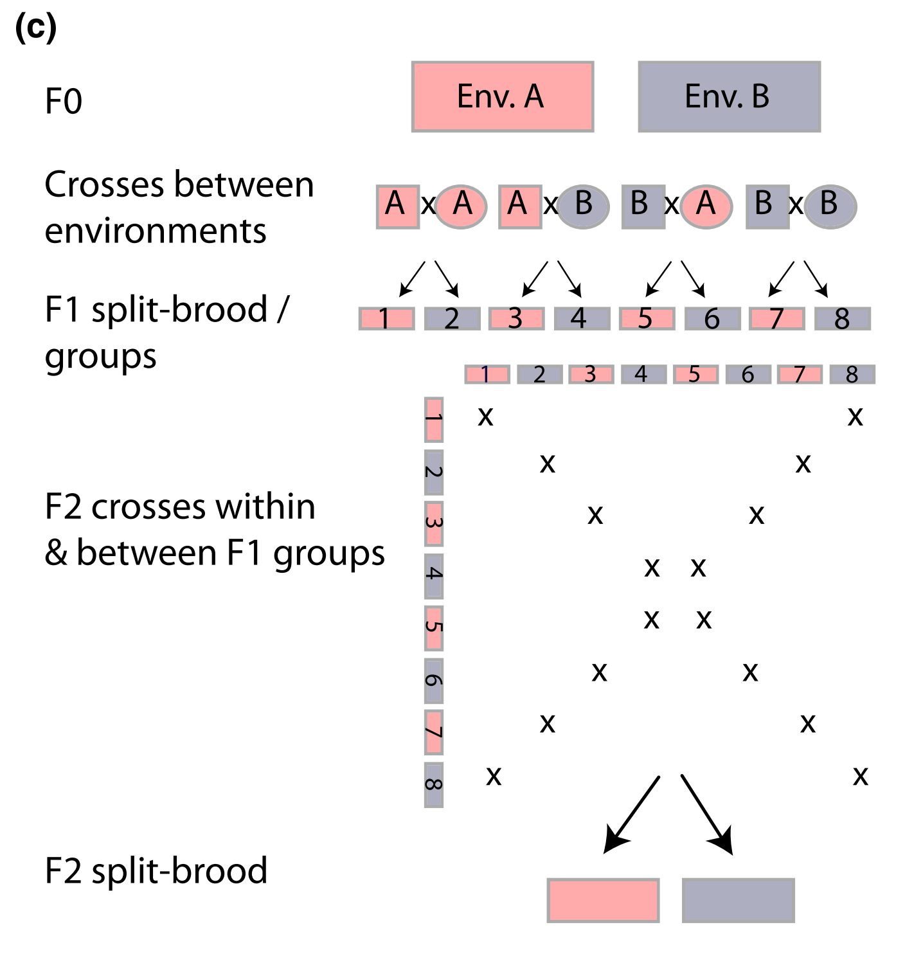
Q5: How can we quantify phenotypic plasticity?
Experimental Design (c):
Rxn norm for each generation
WGP in each generation
Split –brood, testing TGP (PE X OE)
Confounded by different genotypes in each environmental line
Separate maternal/paternal effects
Separate parent/grandparent effects
Can test WGP X TGP interactions
Donelson et al. 2017
Notes:
Crosses between parental environments allows separation of maternal vs paternal effects
F2 crosses within and between F1 groups allows separation of maternal vs paternal grandparent effects

Slide 19
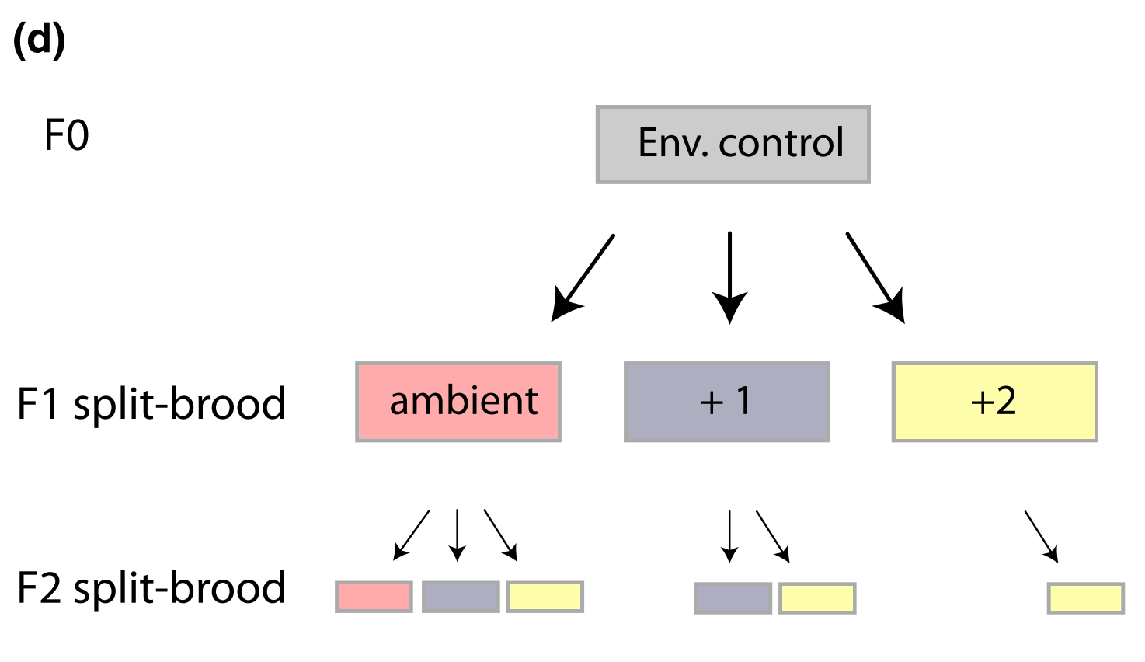
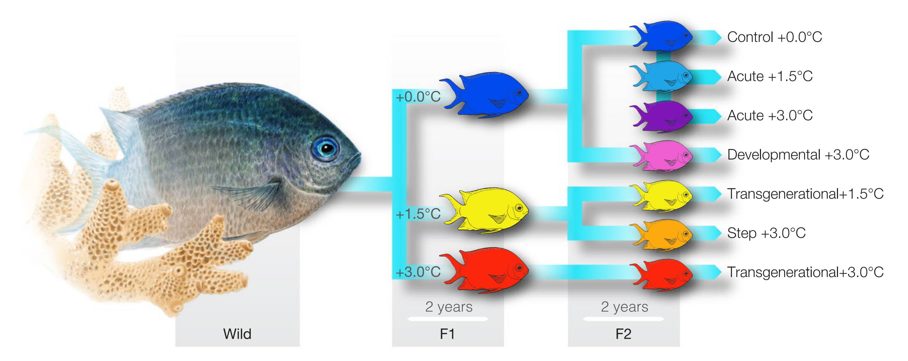
Q5: How can we quantify phenotypic plasticity?
Experimental Design (d):
Rxn norm for each generation
WGP in each generation
Split –brood, testing TGP (PE X OE)
Separate parent/grandparent effects
Can test WGP X TGP interactions
Can test for cue timing effects
3 or more treatments to test non-linear effects
Donelson et al. 2017, Bernal et al. 2018
Notes:
Incremental increase of environmental change
Reduced number of treatments to test specific hypotheses

Slide 20
Outline Epigenetics
Q1: What is epigenetics?
Q2: Epigenetic effect vs inheritance
Q3: What are epigenetic mechanisms?
Q4: How can we quantify epigenetics?
Q5: What is the epigenetic role in environmental acclimatization?

Slide 21
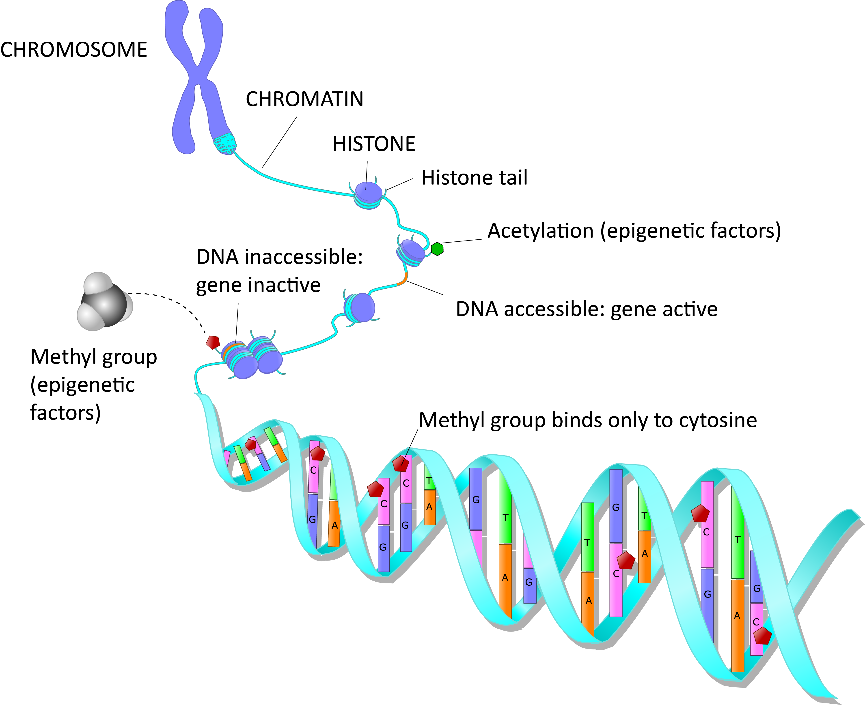
Q1: What is epigenetics?
“Change in heritable (mitotic/meiotic) gene function that cannot be explained by changes in the DNA sequence”

Slide 22

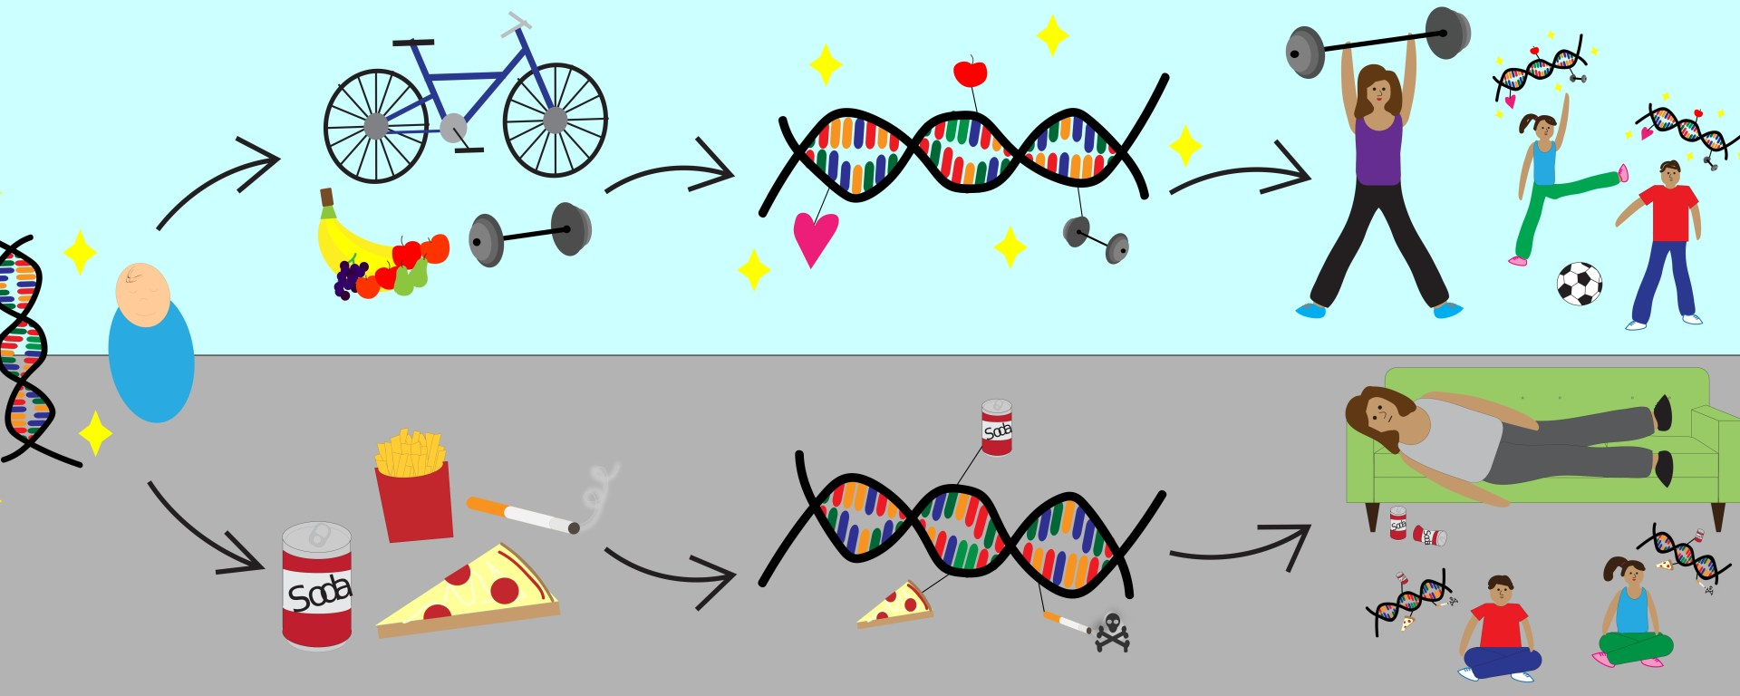
Plasticity and Epigenetics
Plasticity & Heritable Change
Environmental Stimulus
Altered Epigenome

Slide 23
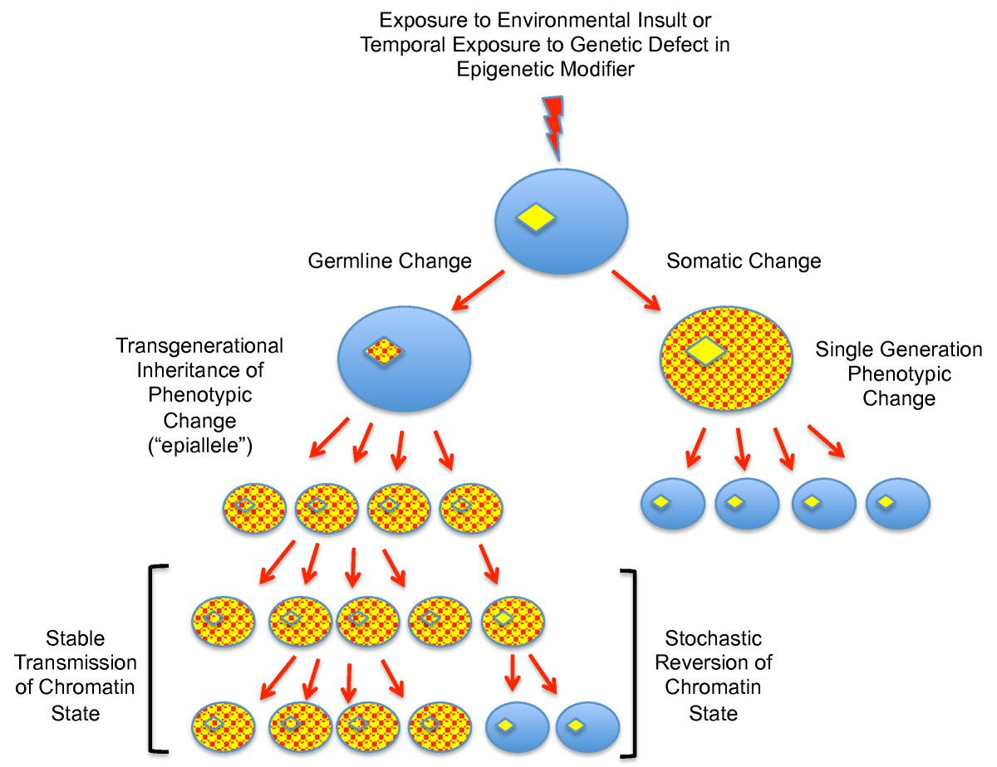
Q2: Epigenetic effect vs inheritance
Transmission of epigenetic states in the soma and germline
Epigenetic effects on soma
Epigenetic inheritance through germline cells
Kelly, 2014
Notes:
Soma (ovals), germline (diamonds)
Right side → somatic change only limited to somatic lineages
Left → germline change may become stabilized with the altered phenotype and may be observed in offspring germ or somatic cells
It is important to understand that the boundaries governing DNA organization and regulation in germ cells are very different from those operating on somatic cells
The interest in epigenetic studies is further reinforced by the capacity of both soma and germline to be affected by dynamic biotic and abiotic conditions, providing mechanisms for acclimatization and adaptation that may be advantageous in a time of rapid environmental change

Slide 24
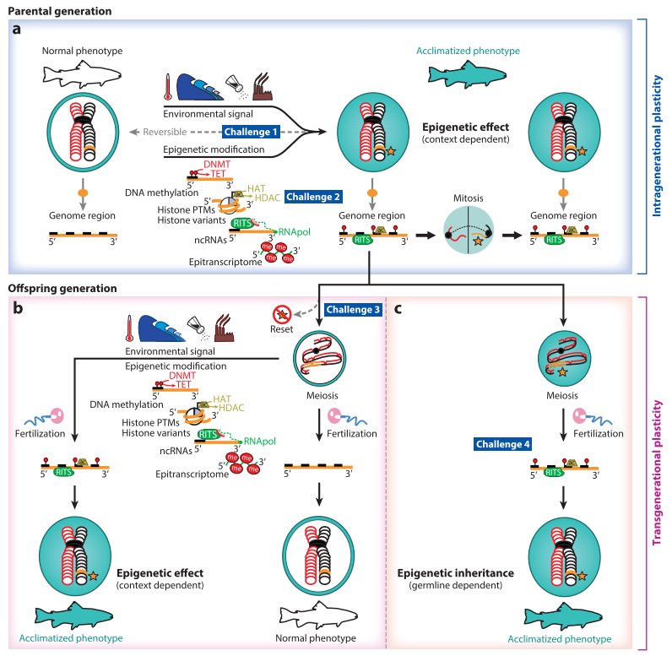
Eirin-Lopez and Putnam, 2019
Notes:
﻿Epigenetic responses to environmental change. (a) Climatic changes trigger epigenetic modifications that modulate alternative and reversible phenotypic manifestations of the genotype. The mitotic transmission of epigenetic marks participates in the propagation of environmentally or developmentally induced states, described as epigenetic effects. The relationship between the magnitude, duration, and type of environmental signals and the specific type, stability, and longevity of epigenetic marks remains to be fully elucidated (challenge 1 in the sidebar titled Future Challenges and Questions). Although epigenetic mechanisms are currently being studied in marine organisms, a detailed understanding of their function and interactions is still lacking (challenge 2 in the sidebar). (b)One of the possibilities for the meiotic transgenerational transmission of epigenetic information, or “memory,” across generations (sexual offspring) requires the persistence of stimuli supporting feedback loops, maintaining epigenetically induced phenotypes or context-dependent epigenetic effects. Yet the mechanisms underlying the communication of signals between soma and germline and their ability to endure the reorganization of chromatin during gametogenesis remain obscure (challenge 3 in the sidebar). (c) Alternatively, true epigenetic transgenerational inheritance (i.e., the transmission and persistence of specific epigenetic modifications in the germline) could occur without the persistence of the causative environmental conditions across generations, or germline-dependent inheritance. While animal model experiments are consistent with the possibility of both (e.g., the agouti locus in mice), the existence of true transgenerational inheritance and its evolutionary implications remain contentious (challenge 4 in the sidebar). Abbreviations: ac, acetylation; DNMT, DNAmethyltransferase;HAT, histone acetyltransferase; HDAC, histone deacetylase; me, methylation; ncRNA, noncoding RNA;PTM, posttranslational modification; RITS, RNA-induced transcriptional silencing; RNApol,RNApolymerase; TET, ten eleven translocation.

Slide 25
Eirin-Lopez and Putnam, 2019
Notes:
﻿Epigenetic responses to environmental change. (a) Climatic changes trigger epigenetic modifications that modulate alternative and reversible phenotypic manifestations of the genotype. The mitotic transmission of epigenetic marks participates in the propagation of environmentally or developmentally induced states, described as epigenetic effects. The relationship between the magnitude, duration, and type of environmental signals and the specific type, stability, and longevity of epigenetic marks remains to be fully elucidated (challenge 1 in the sidebar titled Future Challenges and Questions). Although epigenetic mechanisms are currently being studied in marine organisms, a detailed understanding of their function and interactions is still lacking (challenge 2 in the sidebar). (b)One of the possibilities for the meiotic transgenerational transmission of epigenetic information, or “memory,” across generations (sexual offspring) requires the persistence of stimuli supporting feedback loops, maintaining epigenetically induced phenotypes or context-dependent epigenetic effects. Yet the mechanisms underlying the communication of signals between soma and germline and their ability to endure the reorganization of chromatin during gametogenesis remain obscure (challenge 3 in the sidebar). (c) Alternatively, true epigenetic transgenerational inheritance (i.e., the transmission and persistence of specific epigenetic modifications in the germline) could occur without the persistence of the causative environmental conditions across generations, or germline-dependent inheritance. While animal model experiments are consistent with the possibility of both (e.g., the agouti locus in mice), the existence of true transgenerational inheritance and its evolutionary implications remain contentious (challenge 4 in the sidebar). Abbreviations: ac, acetylation; DNMT, DNAmethyltransferase;HAT, histone acetyltransferase; HDAC, histone deacetylase; me, methylation; ncRNA, noncoding RNA;PTM, posttranslational modification; RITS, RNA-induced transcriptional silencing; RNApol,RNApolymerase; TET, ten eleven translocation.

Slide 26
Eirin-Lopez and Putnam, 2019
Notes:
﻿Epigenetic responses to environmental change. (a) Climatic changes trigger epigenetic modifications that modulate alternative and reversible phenotypic manifestations of the genotype. The mitotic transmission of epigenetic marks participates in the propagation of environmentally or developmentally induced states, described as epigenetic effects. The relationship between the magnitude, duration, and type of environmental signals and the specific type, stability, and longevity of epigenetic marks remains to be fully elucidated (challenge 1 in the sidebar titled Future Challenges and Questions). Although epigenetic mechanisms are currently being studied in marine organisms, a detailed understanding of their function and interactions is still lacking (challenge 2 in the sidebar). (b)One of the possibilities for the meiotic transgenerational transmission of epigenetic information, or “memory,” across generations (sexual offspring) requires the persistence of stimuli supporting feedback loops, maintaining epigenetically induced phenotypes or context-dependent epigenetic effects. Yet the mechanisms underlying the communication of signals between soma and germline and their ability to endure the reorganization of chromatin during gametogenesis remain obscure (challenge 3 in the sidebar). (c) Alternatively, true epigenetic transgenerational inheritance (i.e., the transmission and persistence of specific epigenetic modifications in the germline) could occur without the persistence of the causative environmental conditions across generations, or germline-dependent inheritance. While animal model experiments are consistent with the possibility of both (e.g., the agouti locus in mice), the existence of true transgenerational inheritance and its evolutionary implications remain contentious (challenge 4 in the sidebar). Abbreviations: ac, acetylation; DNMT, DNAmethyltransferase;HAT, histone acetyltransferase; HDAC, histone deacetylase; me, methylation; ncRNA, noncoding RNA;PTM, posttranslational modification; RITS, RNA-induced transcriptional silencing; RNApol,RNApolymerase; TET, ten eleven translocation.

Slide 27
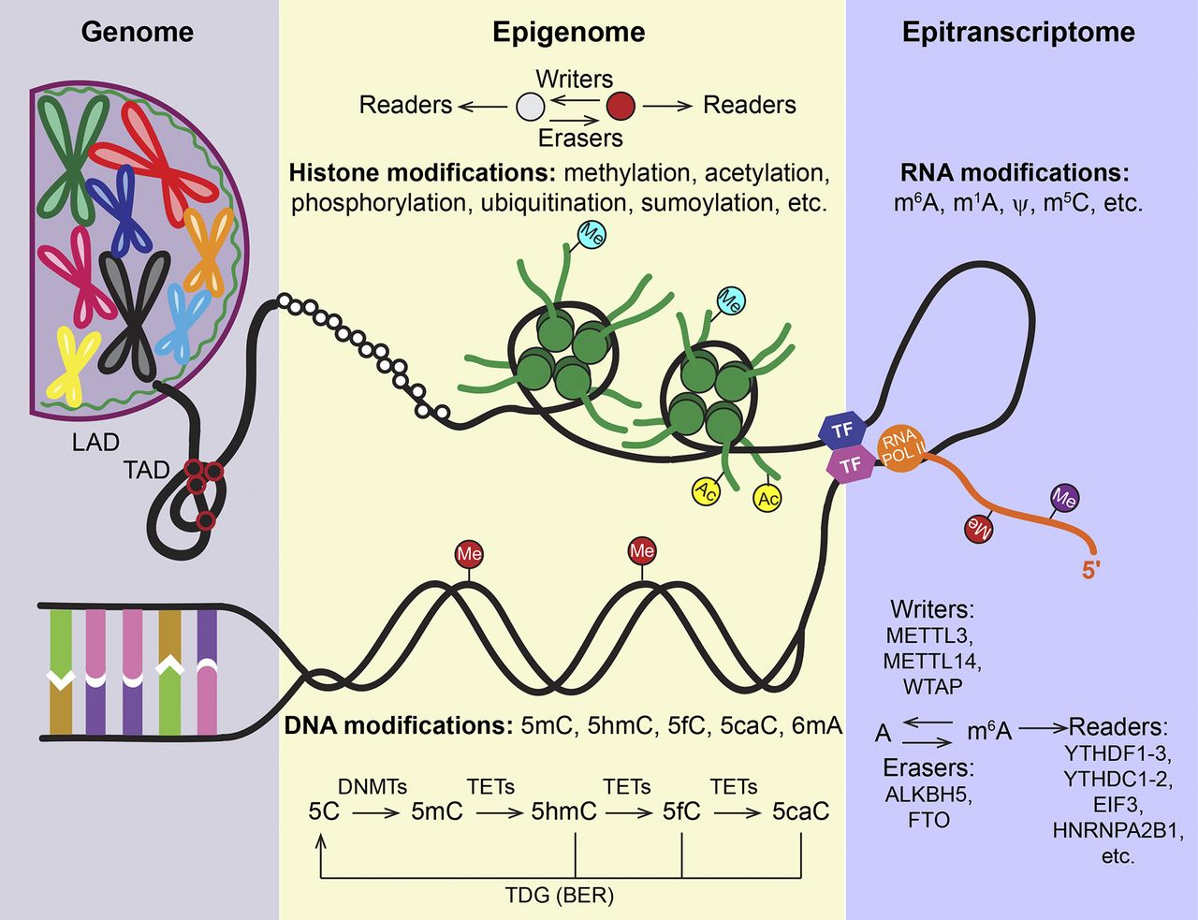
Q3: What are epigenetic mechanisms?

Slide 28
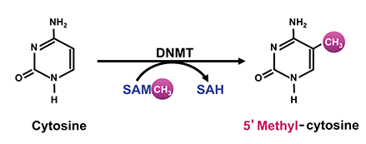
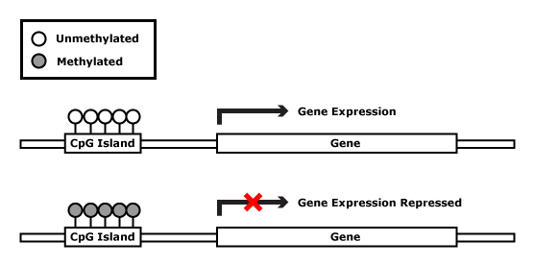
DNA Methylation
Methyl group added to cytosine molecules by DNMT enzymes
Can repress transcription in 2 ways:
Binding to DNA directly and impede binding of transcriptional proteins (CpG islands)
Methylated DNA may be bound by methyl-CpG-binding domain proteins (MBDs)
Notes:
Occurs at C5 of the cytosine ring within cytosine-guanine (CpG) dinucleotides
CpG islands are 1) a length greater than 200bp, 2) a G+C content greater than 50%, 3) a ratio of observed to expected CpG greater ta 0.6. They are major regulator units and 50% of CpG island are located in promoter regions
When CpG island are methylated, there is a direct correlation with repression of transcription, however is it not reciprocally correlated
MBD proteins can recruit additional proetins that can remodel chromatin to also repress transcription in another way

Slide 29
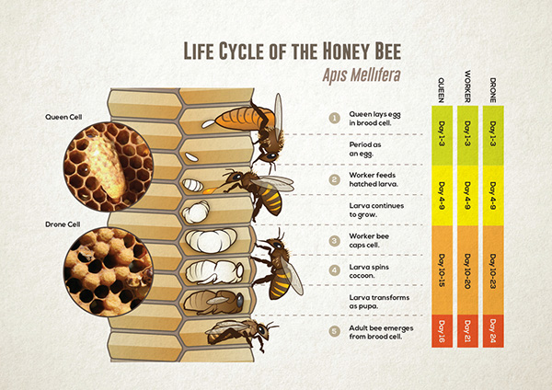
DNA Methylation

Slide 30
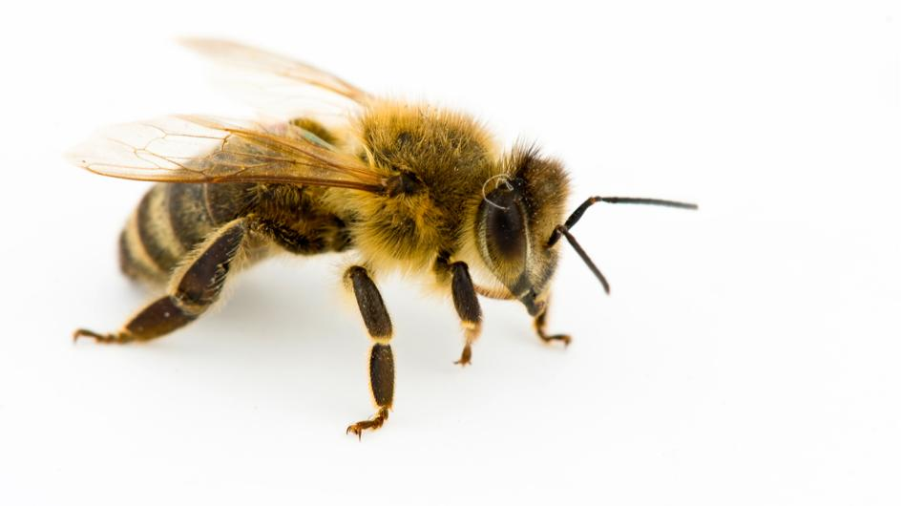
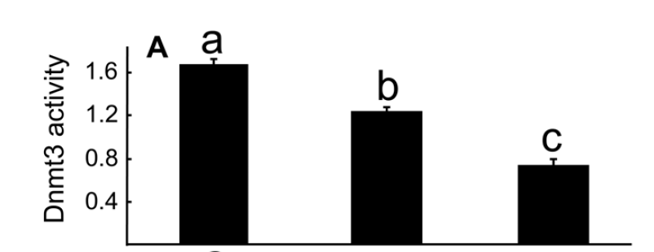
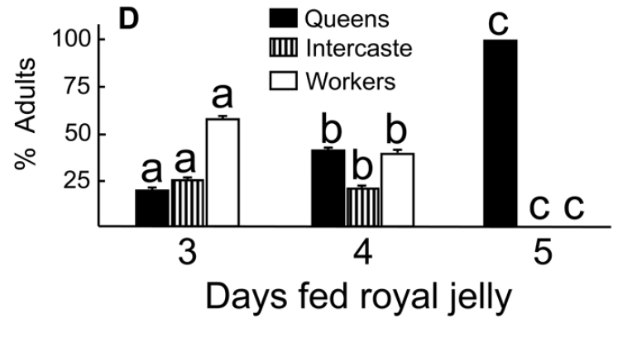
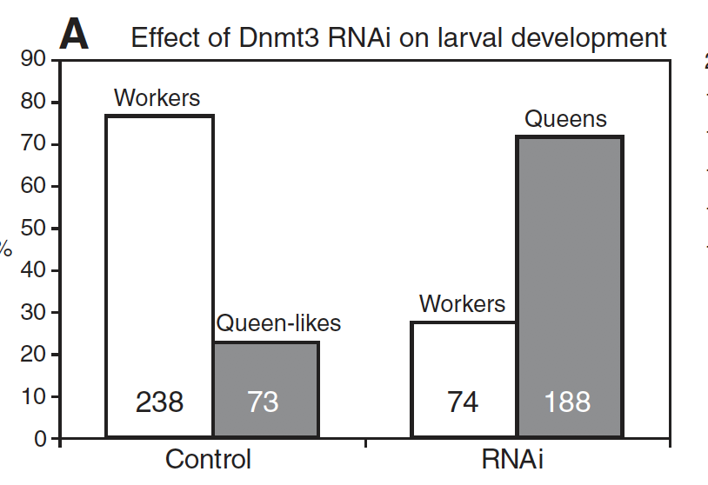
DNA Methylation
Larvae of Apis mellifera (honey bees) can become either queen or workers
DNA methylation is known to regulate expression patterns if dyactin p62 gene resulting in altered phenotypes
When fed royal jelly, repressed DNMT results in queen phenotype
Shi et al. 2011; Kucharski et al. 2008

Slide 31
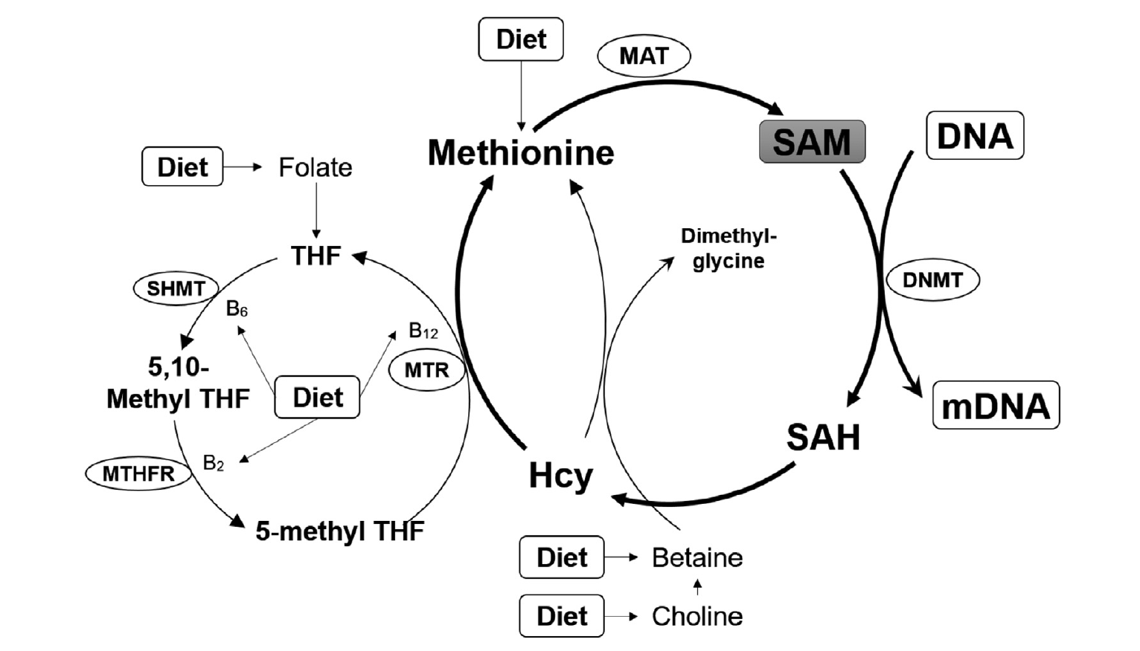


DNA Methylation and Nutrition
Nutrition
DNMT abundance
Queen Bee Phenotype
dynactin expression
Methylated DNA
Zhang et al. 2015

Slide 32
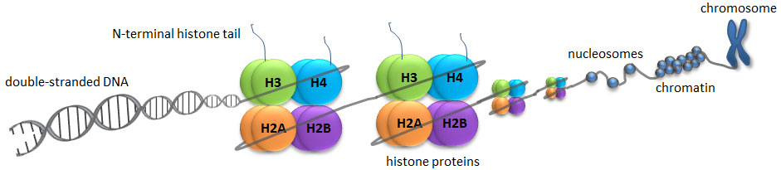
Chromatin Structure
Histone modifications are:
Methylation
Phosphorylation
Acetylation
Ubiquitylation
Sumoylation
Histone modifications can impact gene expression by altering chromatin structure or recruiting histone modifiers
https://www.whatisepigenetics.com/histone-modifications/
Notes:
Histone proteins act to package DNA, which wraps around the eight histones, into chromosomes
By remodelling chromatin complexes, it influences transcription and DNA processes (repair, replication, recombination)

Slide 33
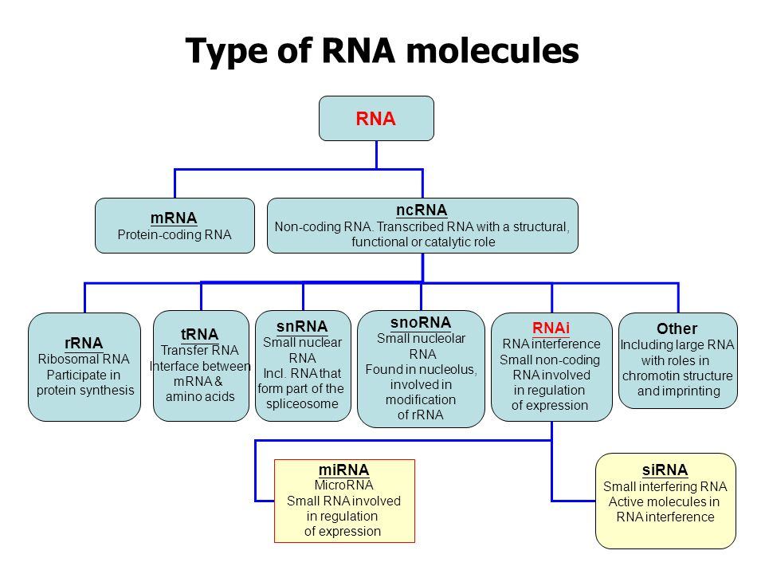
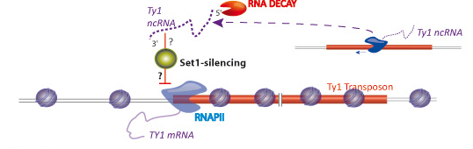
Non-coding RNA
Formation of RNA structures that facilitate the recruitment of chromatin modifiers
Can be horizontally transferred between cells
Can be methylated like DNA → refered to as “epitranscriptome”
Notes:
Various classes of RNA can be transferred horizontally across neighbouring cells through extracellular vesicles, promoting environmental signmal transduction, as well as potentially altering the epigenome of neighbouring cells by carrying RNA-binding proteins
Afigure: depiciting how the trans-acting Ty1 ncRNA inhibits the RNA ploymerase II of the Ty1 transposon through Set 1 Activity

Slide 34
Q4: How can we quantify epigenetics
DNA Methylation
CpG O/E
Global DNA methylation
Bisulfite sequencing methods
Histone Modifications
Histone extraction and immuno-detection
ChIP sequencing
Noncoding RNAs
sRNA sequencing

Slide 35
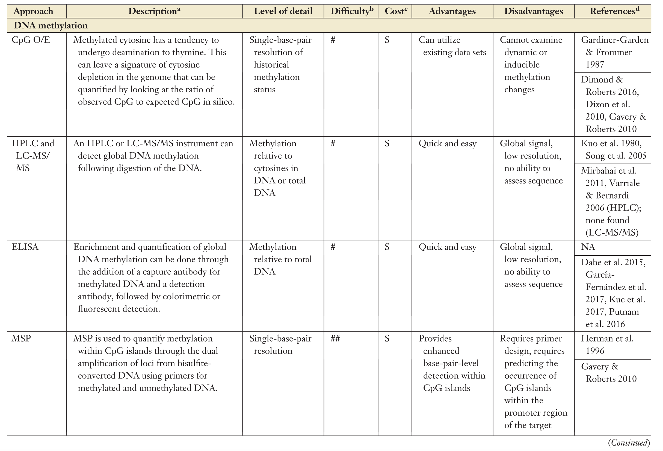
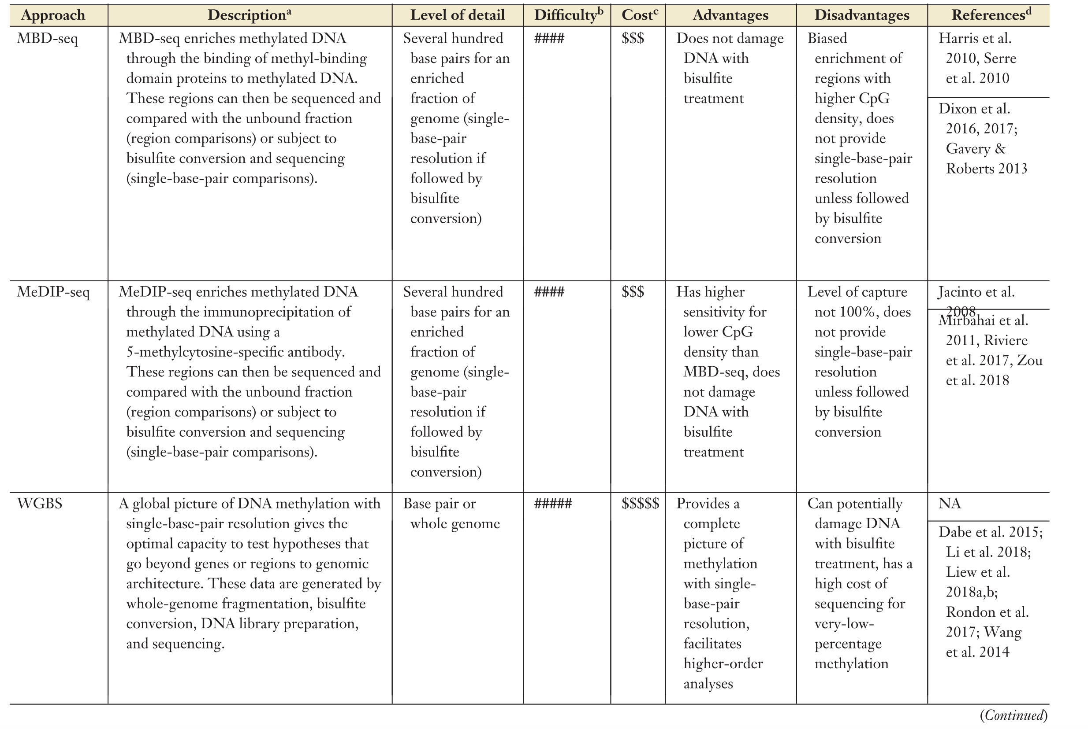
Q5: How can we quantify epigenetics

Slide 36
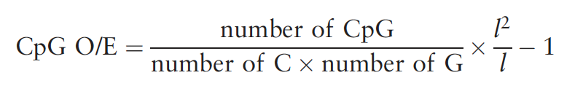
DNA Methylation:
CpG Observed/Expected
Methylated cytosines convert to thymines over time
Notes:
﻿
Methylated cytosines convert to thymines over time
Results in reduction of CpG dinucleotides, meaning that heavily methylated genomic regions are associated with reduced numbers of CpGs
Thus methylation patterns that have been inherited through the germline over evolutionary time can be estimated using the ratio O/E

Slide 37
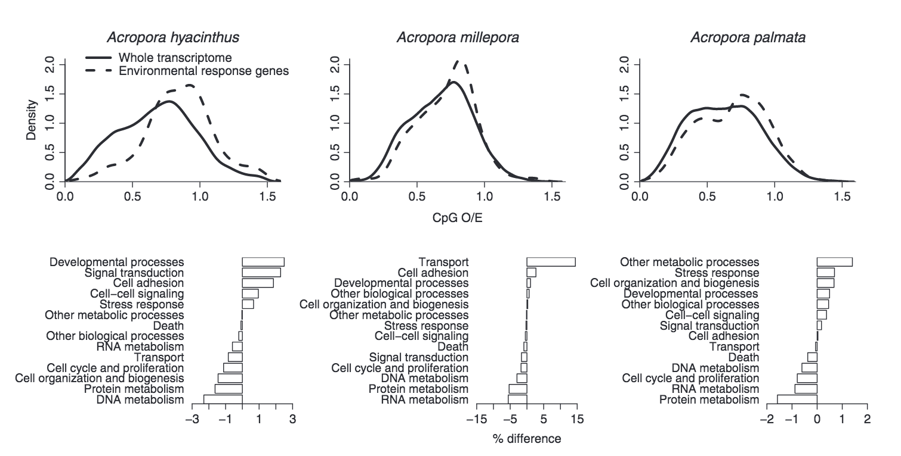
DNA Methylation: CpG Observed/Expected
Dimond and Roberts, 2016
Notes:
﻿
Comparison of transcriptome-wide (solid) and differentially expressed gene (dashed) CpG O/E in acroporid corals
Hypermethylated fractions were associated with housekeeping genes
Hypomethylated fractions ere associated with inducible genes (environmentally sensitive)

Slide 38

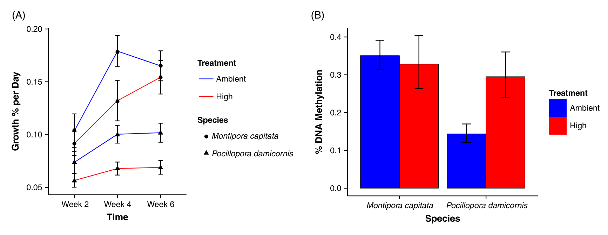
DNA Methylation:
Global DNA Methylation
DNA is bound to strip-wells
Methylated fraction of DNA is detected using capture and detection anti-bodies
Quantified colormetrically on a spectrophotometer
Putnam et al. 2016
Notes:
﻿

Slide 39
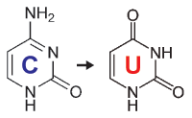
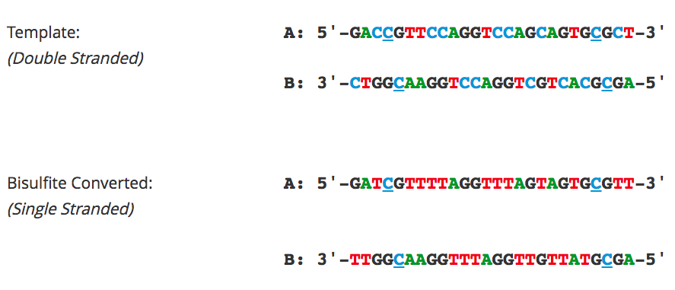
DNA Methylation: Bisulfite Sequencing
Bisulfite Conversion
Gold standard
Unmethylated cytosines undergo hard bisulfite treatment
Methylated cytosines are immune to this conversion
Methylation Sites
https://www.zymoresearch.com/pages/bisulfite-beginner-guide
Notes:
﻿- gold-standard technology for detection of DNA methylation because it provides a qualitative, quantitative and efficient approach toidentify 5-methylcytosine at single base-pair resolution.
Cytosine and 5-methylcytosine (5mC) have different consequences to sodium bisulfite treatments
Unmethylated cytosines will be converted into uracil residues and recognized as thymine in PCR amp and sequencing
5mCs are immune to this conversion

Slide 40
Q5: What is the epigenetic role in phenotypic plasticity?

Slide 41

Q1: What is epigenetics?
Bossdorf et al. 2008

Slide 42
Q1: What is epigenetics?
Bossdorf et al. 2008

Slide 43

Q5: What is the epigenetic role in environmental acclimatization?
Putnam and Gates 2015
Notes:
Organisms respond to environmental drivers through organismxenvironment interactions, but in addition to the classical genetic amplifier, epigenetic response mechanisms are also an amplifier for its ability to create phenotypic plasticity
Plasticity generated will be filtered by selection, resulting in outcomes that may either enhance or diminish response capacity to environmental change
This capacity is then fed back into the population across generations to influence the future population trajectory
Plasticity provides a potential buffer to the rapid rate of environmental change

